Slide 1
Grading updates
Starting today, you need your i>clicker
If your quiz grade isn’t appearing in Canvas, send me an email
Sample questions are due at midnight after every lecture

Slide 2
Graded Quiz Question #1
Which macromolecule has the highest Atwater factor
Carbohydrate
Protein
Fat
They are all the same

Slide 3
Graded Quiz Question #2
Basal metabolic rate decreases with age
Due to increases in fat mass
Largely explained by reductions in fat free mass
Due to decreases in physical activity
Because of increased thermic effect of food

Slide 4
Graded Quiz Question #3

Slide 5
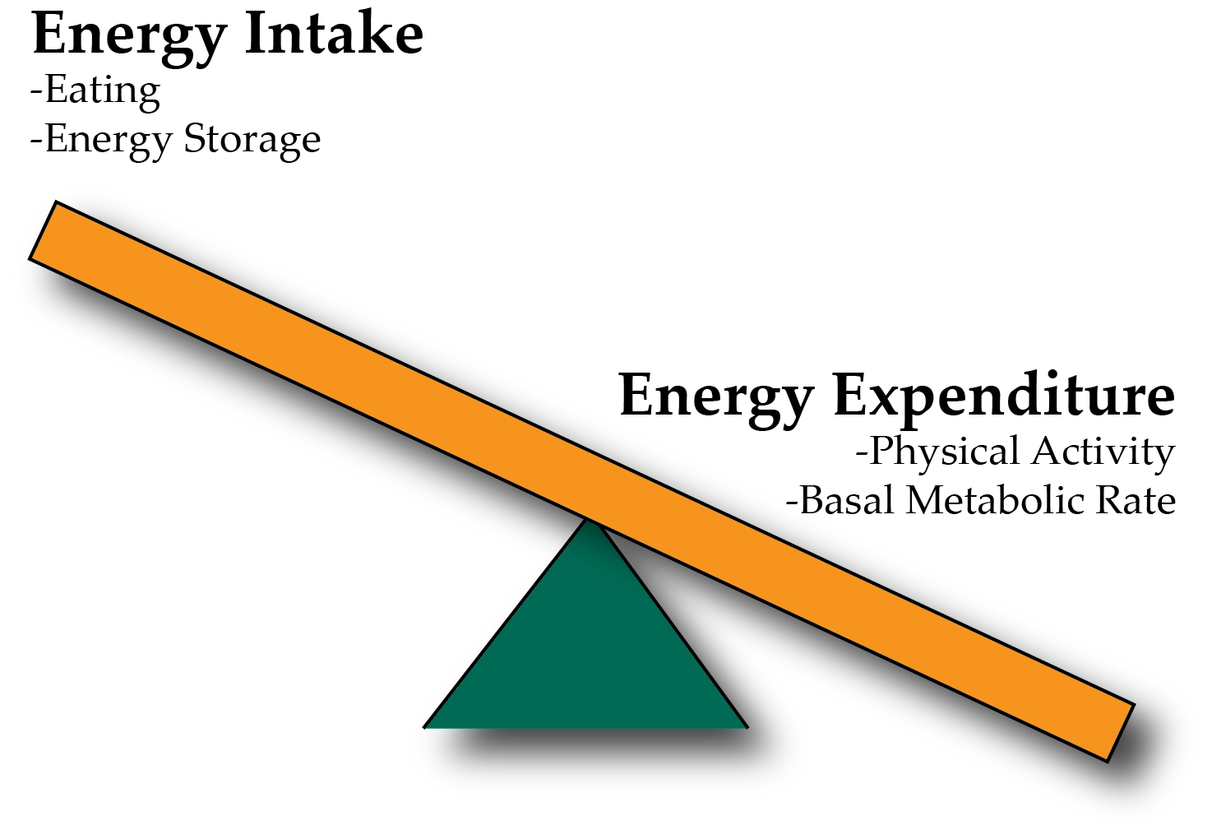
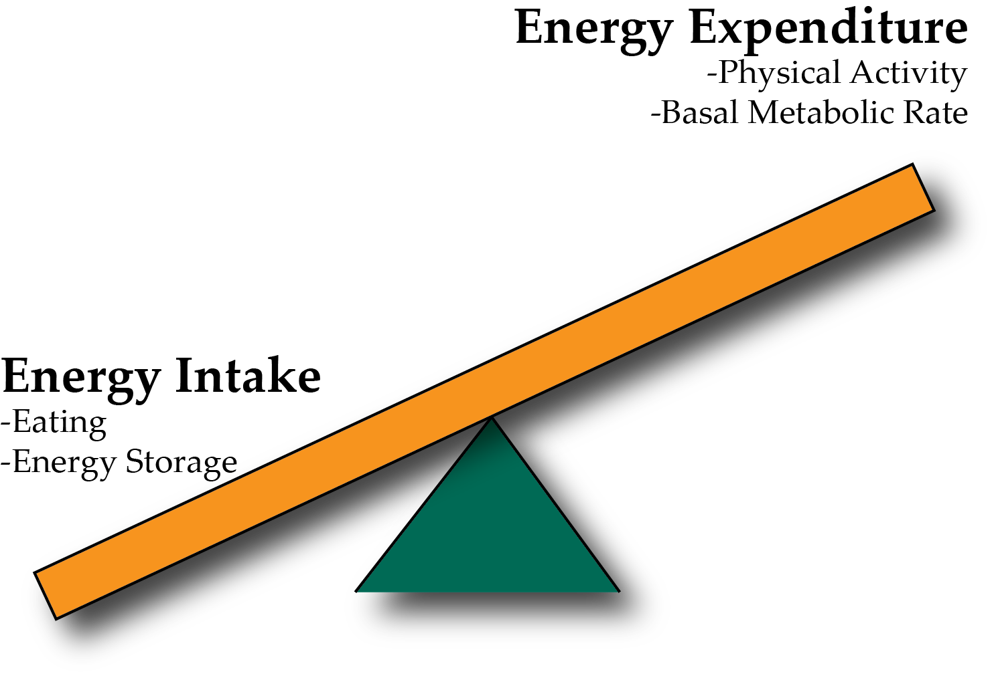
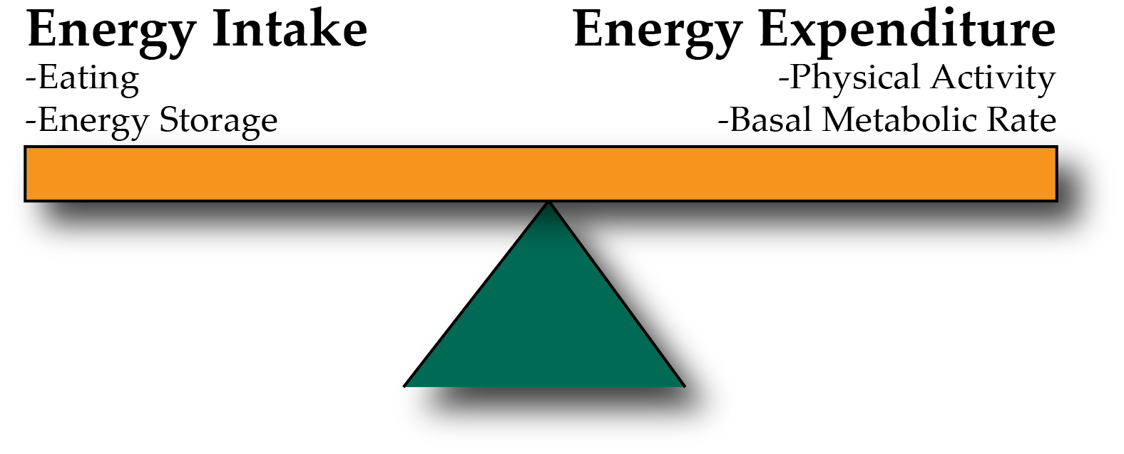
Energy Balance and Obesity
Positive Energy Balance – Weight Gain
Negative Energy Balance – Weight Loss
Notes:
Be here at 9:20

Slide 6
What affects our energy intake?
Nutritional needs
Energy needs
Empty Stomach
Social factors
Stress
Pleasure
Genetics
Taste
Digestion
Notes:
21-45% of macronutrient intake is genetic

Slide 7
Genetics Thought Experiment
What aspects of appetite do you think are
Non-familial
Familial, non-genetic (V_{e})
Genetic (V_{g})
How much of total energy intake do you think is explained by genetics (V_{g})?
<20%
20-40%
40-60%
>60%
Notes:
21-45% of macronutrient intake is genetic

Slide 8
Assessing Energy Intake
Several methods of assessing energy intake
Observational
Diet Recall Surveys
Food Frequency Questionnaires
More on this in the Discussion section this week!

Slide 9
In terms of energy, is a gram of fat equivalent to a gram of protein?
Yes
No
It depends

Slide 10
In terms of energy, is a calorie of fat equivalent to a calorie of protein?
Yes
No
It depends

Slide 11
Why do we start and stop eating?
Why do we eat
Why do we stop eating
Drive for food
Low blood glucose
Stress
Stomach is full
Rise in gut-derived hormones
Rise in insulin and glucose
~20 minute lag between eating and feeling full

Slide 12
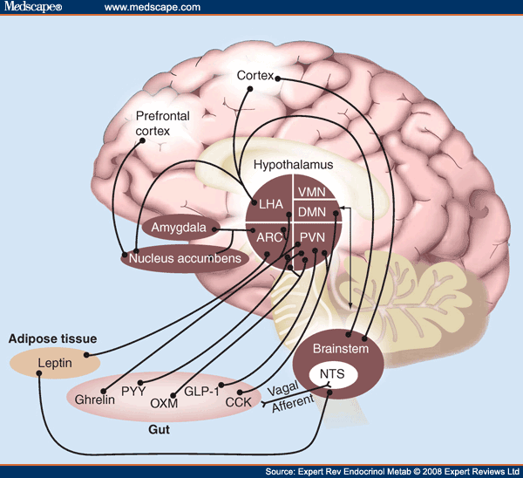
The Central Role of The Hypothalamus

Slide 13
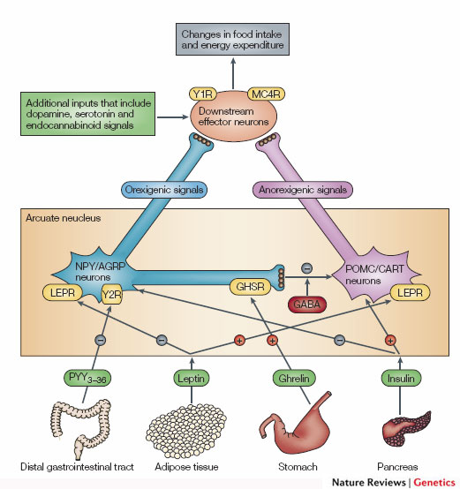
The POMC/AgRP Circuit
Promotes
Eating
Suppresses
Appetite
Notes:
Two populations of neurons in the arcuate nucleus.

Slide 14
Demonstration of AGRP Suppression of Appetite
https://youtu.be/9VolVN3v-YQ

Slide 15
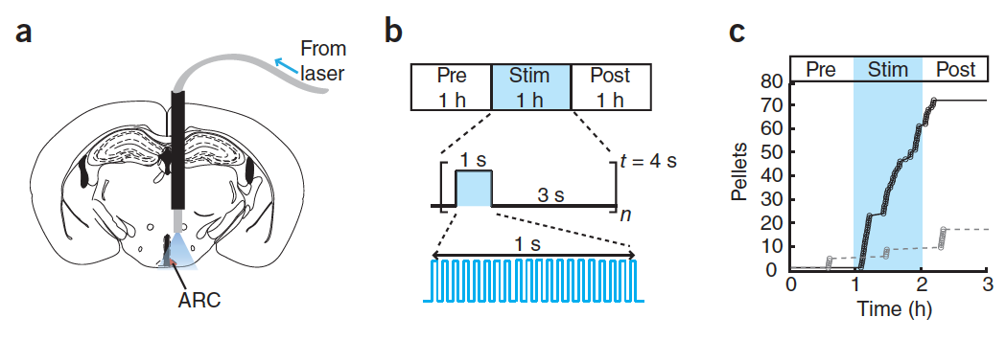
Activation of AGRP Neurons is Sufficient to Promote Hunger
Aponte Y, Atasoy D, Sternson SM. AGRP neurons are sufficient to orchestrate feeding behavior rapidly and without training. Nat Neurosci 2011; 14:351–5.

Slide 16
Neural Control of Appetite (Downstream of AGRP/POMC)
Syndromic obesity variants generally cause over-eating

Slide 17
Stress!!!
Cortisol (a glucocorticoid stress hormone) activates AGRP Neurons
This drives feeding behavior
Adrenaline (a short term stress hormone) also drives appetite

Slide 18
Timed feeding cues
Cortisol awakening response
Sharp rise in cortisol shortly before waking up
May differ between chronotypes
48% genetic
How do you think this would affect feeding behaviors?
Kudielka BM, Federenko IS, Hellhammer DH, Wüst S. Morningness and eveningness: The free cortisol rise after awakening in “early birds” and “night owls.” Biol Psychol. 2006; 72: 141–6. doi: 10.1016/j.biopsycho.2005.08.003.

Slide 19
Why do we stop eating?
The role of our gastrointestinal system
Notes:
~20 minute lag between eating and feeling full

Slide 20
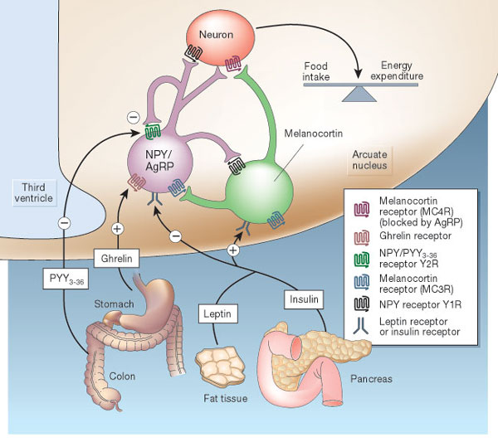
Hormonal Control of Appetite
Notes:
Think about it this way… AgRP neurons like to be on, and when they are on they increase appetite.

Slide 21
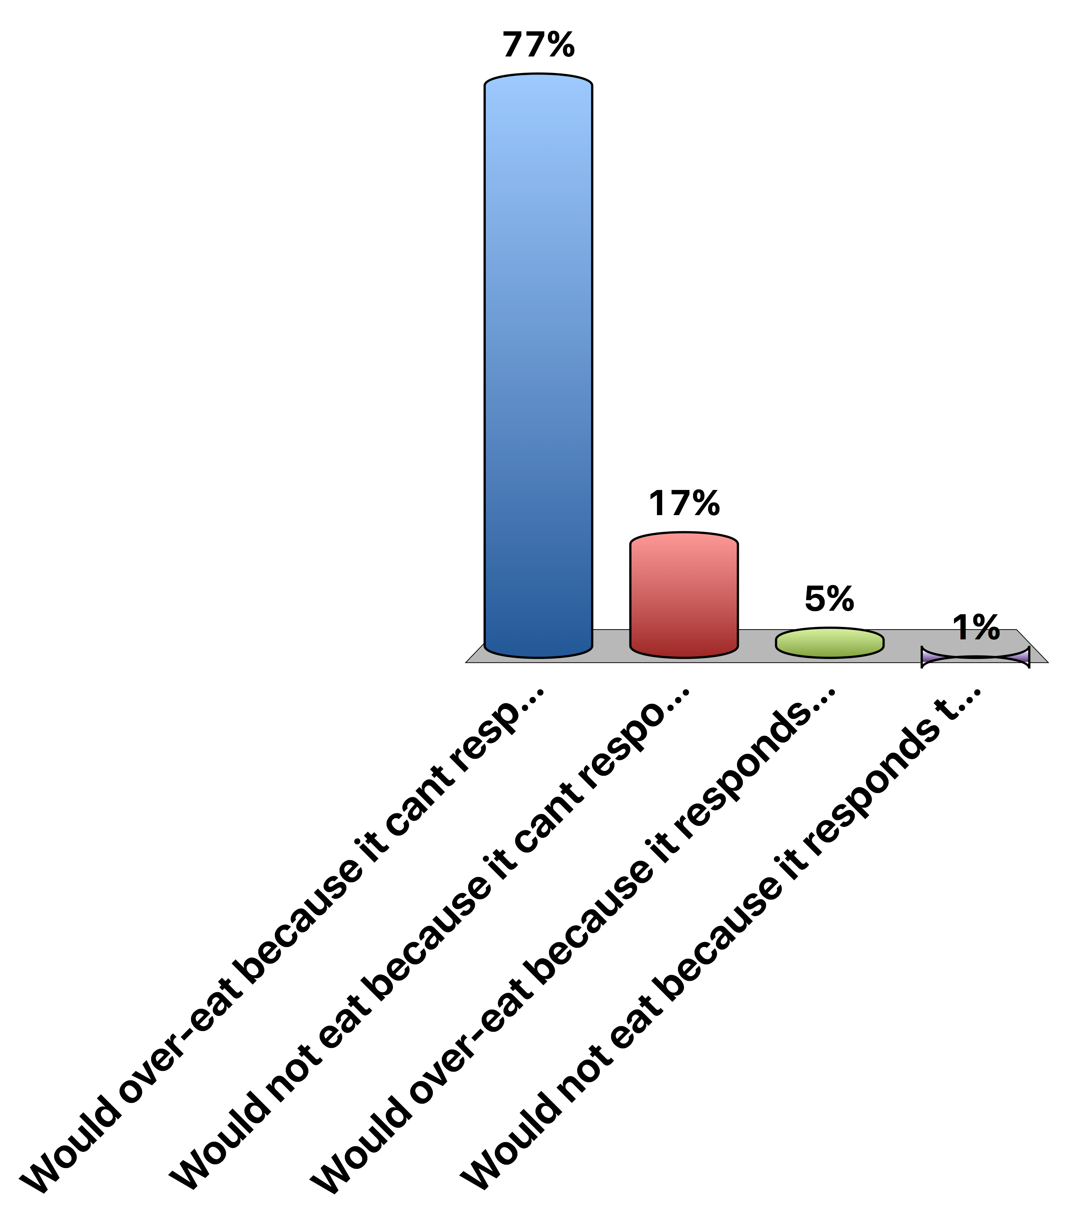
A person with no Leptin Receptor
Would over-eat because it cant respond to leptin
Would not eat because it cant respond to leptin
Would over-eat because it responds too strongly to leptin
Would not eat because it responds too strongly to leptin
0
Notes:
A

Slide 22
Metabolic Signals
Glucose
Signals both at POMC/AgRP and other hindbrain regions to reduce appetitve drive
Insulin
Signals directly at POMC/AgRP circuit to reduce appetitive drive
Proteins and Fats
Potentially suppressive, mechanisms are unclear
Leptin
Related to adipose tissue size

Slide 23
Gastrointestinal Control of Appetite
Notes:
Think about it this way… AgRP neurons like to be on, and when they are on they increase appetite.

Slide 24
Vagal Nerve Signaling
Notes:
Enteric nervous system
Second brain
500 million neurons

Slide 25
Gut Derived Appetite Hormones
Appetite Promoting
Ghrelin
Appetite Suppressing
GLP1
PYY
CCK

Slide 26
Ghrelin, the Hunger Hormone

Slide 27
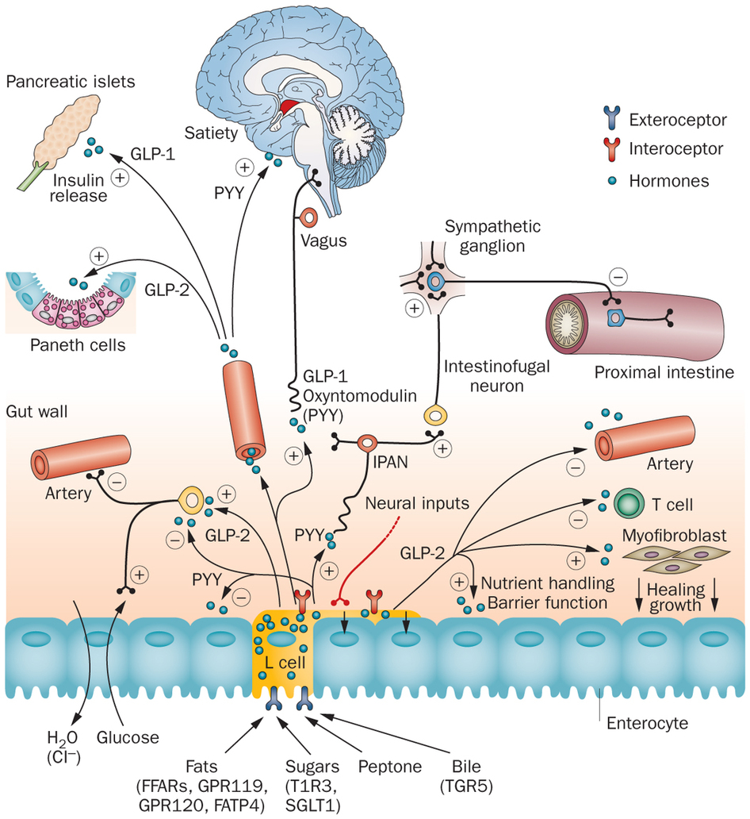
PYY
Secreted from the small intestine

Slide 28
GLP-1 (Glucagon-Like Peptide 1)

Slide 29
GLP-1 Agonists as anti-Obesity Drugs
Liragutide is a GLP-1 analog
Wadden TA, Hollander P, Klein S, Niswender K, Woo V, Hale PM, Aronne L. Weight maintenance and additional weight loss with liraglutide after low-calorie-diet-induced weight loss: The SCALE Maintenance randomized study. Int J Obes. Nature Publishing Group; 2013; 37: 1443–51. doi: 10.1038/ijo.2013.120.

Slide 30
Summary of gut signals
Signal | Effect of food | Effect
Vagal stimulation | Stimulation | Inhibitory
GLP-1 | Secreted by small intestine | Inhibitory
PYY (Peptide YY) | Secreted by small intestine | Inhibitory
CCK | Secreted by small intestine | Inhibitory
Ghrelin | Stomach secretion stops with food | Activating

Slide 31
Endocrine Regulation of GI Function

Slide 32
Summary of Enteroendocrine Hormones
Hormone | Released from | Roles
Gastrin | Stomach and Small Intestine (Amino acids, stomach stretch) | Release acid into stomach, increase motility
Secretin | Small Intestine (Acid) | Release bicarbonate into small intestine
CCK (Cholecystokinin) | Small Intestine (Fatty acids and amino acids) | Bile Secretion, Pancreatic Enzyme Secretion, reduces motility
Motilin | Small Intestine | Increased motility
Parasymathetic Nervous System | Brain | Rest and digest, release of CCK
Sympathetic Nervous System | Brain | Fight or flight, pyloric sphincter

Slide 33
Energy Expenditure and Metabolism

Slide 34
How do we measure metabolic rates

Slide 35
Parts of the Metabolic Rate Metabolic Rate
Energy Expenditure Component | Increased by
Exercise Activity Thermogenesis (NEAT/EAT) | Exercise and movement
Thermic Effect of Food (TEF) | Protein in Meal, Insulin Sensitivity, Meal Size
Basal Metabolic Rate | Young Age, Sex (M), Lean Mass, Set Point
Maclean PS, Bergouignan A, Cornier M-A, Jackman MR. Biology’s response to dieting: the impetus for weight regain. Am. J. Physiol. Regul. Integr. Comp. Physiol. 2011;301(3):R581–R600. http://dx.doi.org/10.1152/ajpregu.00755.2010
Notes:
Impact of weight loss on the components of total energy expenditure (TEE). Energy-restricted weight loss impacts every component of energy expenditure. The absolute levels of resting energy expenditure (REE) decline from a loss of metabolic mass and enhanced metabolic efficiency. Nonresting energy expenditure (NREE) declines, unless the level of physical activity and its associated exercise activity thermogenesis (EAT) are substantially increased. This increase must overcome the decline in the TEF that results from lower energy consumption and a decline in nonexercise activity thermogenesis (NEAT) related to loss in overall mass. Increased energetic efficiency of EAT, NEAT, and potentially TEF contribute to the overall decline in NREE.

Slide 36
Benefits of Physical Exercise
Flexibility
Strength
Mood
Cardiovascular health
Benefits at all BMI categories
Blair SN, Kohl HW, Paffenbarger RS, Clark DG, Cooper KH, Gibbons LW. Physical fitness and all-cause mortality. A prospective study of healthy men and women. JAMA. 1989; 262: 2395–401. doi: 10.1001/jama.1989.03430170057028.

Slide 37
Major Determinants of Energy Expenditure
Amount of metabolically active tissue (fat-free mass)
How inefficient that tissue is
In terms of weight loss, inefficiency is good
Strong relationship between REE and Fat-Free Mass
Modified by
Age (declines with age)
Sex (~11% higher in males)
Genetics (V_{g} ~ 11%)
Illner K, Brinkmann G, Heller M, Bosy-Westphal A, Muller MJ. Metabolically active components of fat free mass and resting energy expenditure in nonobese adults. Am J Physiol Endocrinol Metab. 2000; 278: E308-15.
Notes:
The major factors that contribute to the BMR are age (declines with age), sex (approximately 11 % higher in males) and body mass, particularly fat-free (or lean) mass. Up to 85 % of the variance in BMR can be explained by these factors,

Slide 38
The 3500 Calorie “Rule”
Based on the amount of calories in a lb of human fat tissue (87% lipid)
Calculate the number of calories in one pound (453g) fat based on Atwater numbers and the percent of lipid in fat.
To lose that amount of weight how many calories would be need to reduced per day, presuming EE is constant. Consider if your timeframe is
One year,
One month,
One week, and
One day
What if someone wanted to lose 35 lbs in 3 months?

Slide 39
This does not work, why?

Slide 40
How do you think over-eating alters the basal metabolic rate?
I think metabolic rate would be lower after over-eating
I think metabolic rate would be higher after over-eating
What do you think fasting or caloric restriction would do to the metabolic rate?

Slide 41
Over/underfeeding and metabolic rates
Leibel R, Osenbaum MIR, Leibel RL, Rosenbaum M, Hirsch J. Changes in energy expenditure resulting from altered body weight. N. Engl. J. Med. 1995;332(10):621–8. http://dx.doi.org/10.1056/NEJM199503093321001

Slide 42
The Biggest Loser Follow-Up Study
Notes:
Those with sustained weight loss, did so even in spite of a more pronounced reduction in RMR after 6 years

Slide 43
A dynamic model of weight loss
Negative energy balance
Loss of mass
Reduction in energy expenditure
Less negative energy balance
Slowing of weight loss
https://www.niddk.nih.gov/bwp

Slide 44
Relevance of caloric elasticity to public policy
USDA Report on a Soda Tax
Taxing Sodas at 20%
Estimated to reduce calories by 40 Cal/day
Non-adapted model
Adaptive model
Hall, K. D. et al. Quantification of the effect of energy imbalance on bodyweight. Lancet 378, 826–837 (2011).

Slide 45
How does weight loss affect appetite hormones
Why does ghrelin go down, but PYY go up with a meal?
Sumithran P, Prendergast LA, Delbridge E, Purcell K, Shulkes A, Kriketos A, Proietto J. Long-Term Persistence of Hormonal Adaptations to Weight Loss. N Engl J Med. 2011; 365: 1597–604. doi: 10.1056/NEJMoa1105816.

Slide 46
How does weight loss affect hunger?

Slide 47
What is the relationship between intake and expenditure?

Slide 48
Relationship between activity and intake
Over a Day
Over the Week
Edholm OG. Energy balance in man studies carried out by the Division of Human Physiology, National Institute for Medical Research. J Hum Nutr. 1977; 31: 413–31.

Slide 49
Learning Objectives
Understand what a rate limiting enzyme is, what a committed enzyme step is and what a reversible reaction is.
Explain the differences in speed and persistence of allosteric, post-translational and transcriptional regulation of metabolism.
Describe the role of cellular transport in macromolecular regulation. Understand the differences between active and passive transport.
Describe how hormones alter macronutrient metabolism after a meal.
Explain the roles of hormones that maintain glucose levels in the fasting state.
Understand how metabolic rates are changed in response to diets and overfeeding.

